Slide 1

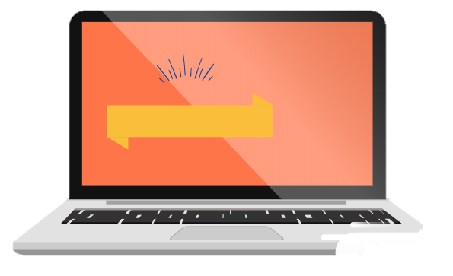

A Final Project in DaStruc and EBusRec
By: Aliah Casabuena
April 2019

Slide 2
Chapter 1
Introduction

Slide 3
Statement of the Problem
Lack of knowledge and awareness

Slide 4


Talking about disabilities…

Slide 5


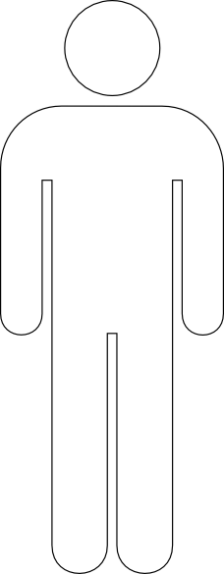

1.5M
Per year
1M
Suicide Cases
2020
Per year
International Association for Suicide Prevention

Slide 6
Statement of the Problem
Lack of knowledge and awareness
Inefficiency and risk
Lack of time

Slide 7

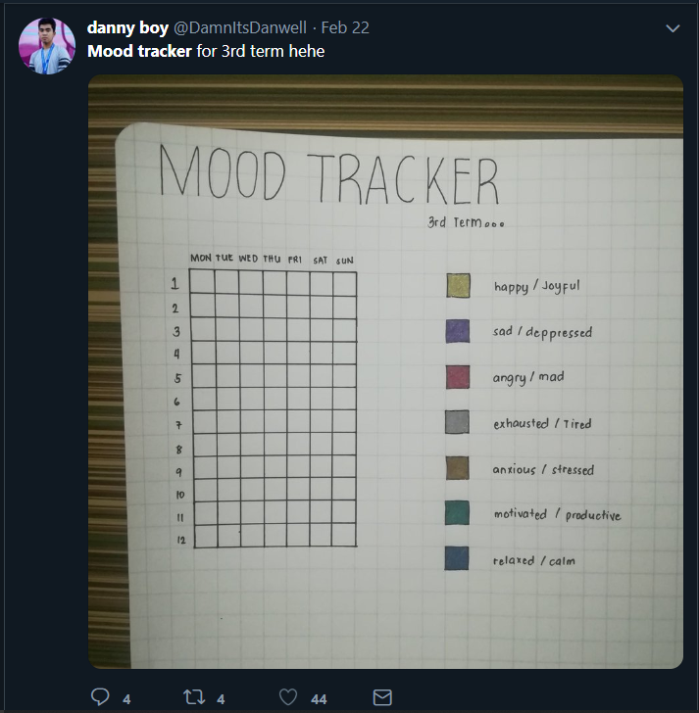
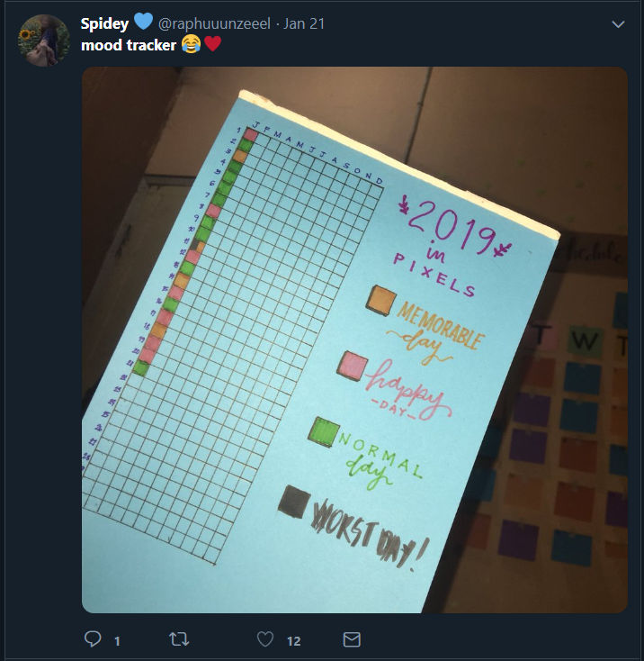
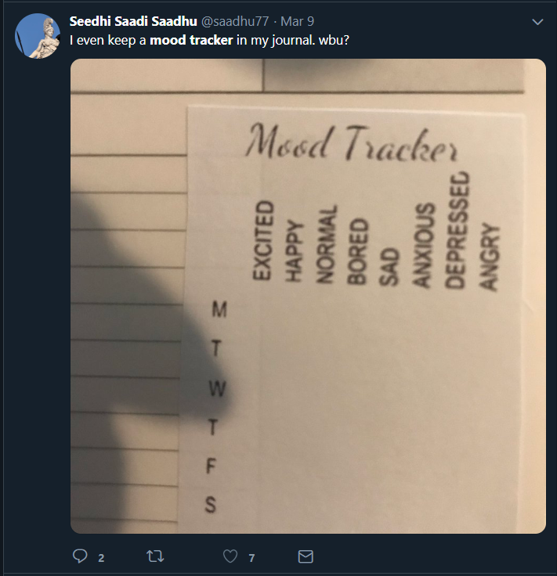

Slide 8
Statement of the Problem
Lack of knowledge and awareness
Inefficiency and risk
Lack of time
Good health and well-being

Slide 9



Slide 10

Objectives
To make a program
To provide a monthly evaluation of the moods.
To provide a simple advice for the user.

Slide 11
"Shake off a sad mood by doing things that put you in a more positive mood. Play a game or sport.“
" Knowing your emotions helps you understand and accept yourself. If you feel sad, notice it."
"To stay happy, Be vulnerable."
" Stay true to yourself."
"Try to spend time with people who love you to elevate your emotions."
"You can adopt a pet, they will help you feel something."

Slide 12
Objectives
To make a program
To provide a monthly evaluation of the moods.
To provide a simple advice for the user.
To Ensure the safety and privacy of the user’s data.

Slide 13
Significance of the Study
The result of the project will benefit the following:
App User
Parents
Doctors and future researchers

Slide 14
Chapter 2
Review of Related
Application and Methods

Slide 15

Methods
Journals
Diaries

Slide 16





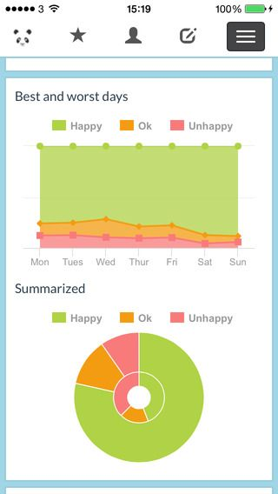
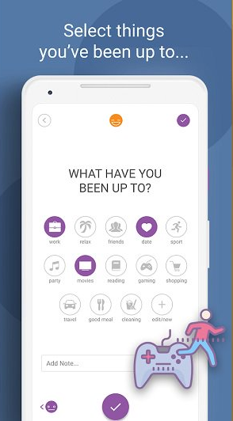

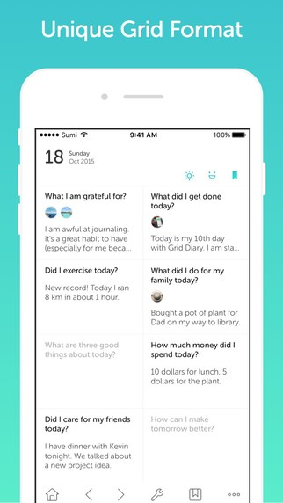
Applications

Slide 17
Chapter 3
Complexity Analysis

Slide 18
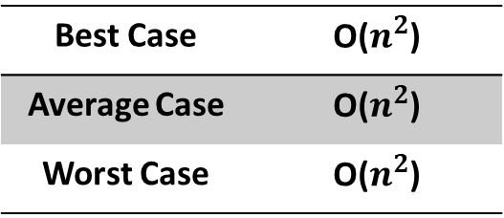
Python 3.7 language
Anaconda: Spyder
Abstract Data type
Graph
Array
Data structures
Lists
Best Case | O(1)
Average Case | O(1)
Worst Case | O(1)
Best Case | O($n^{2}$)
Average Case | O($n^{2}$)
Worst Case | O($n^{2}$)

Slide 19
Chapter 4
The Application

Slide 20

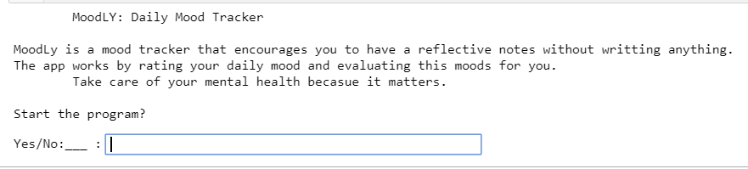
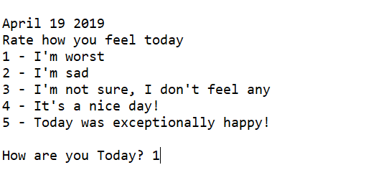
How the program works…
Figure 1. Initial screen
Figure 2. Daily mood tracking

Slide 21
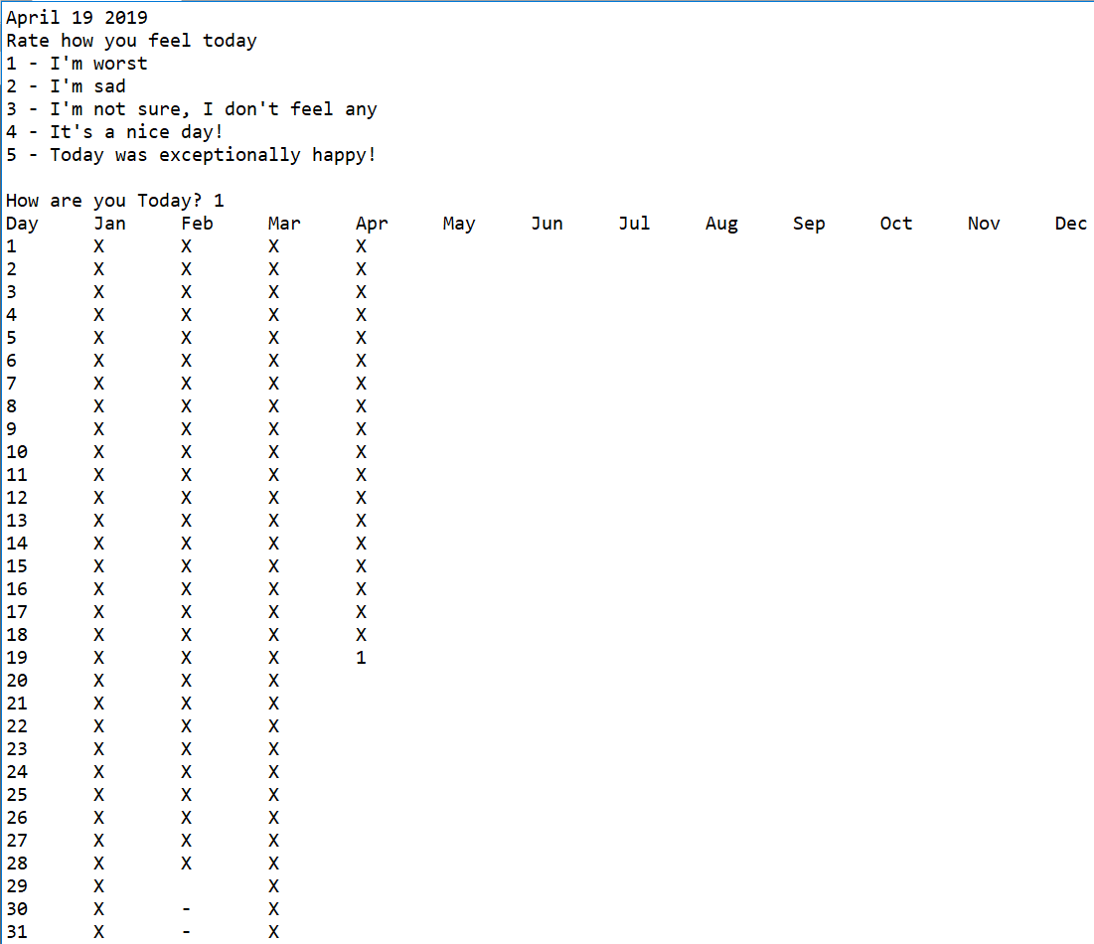
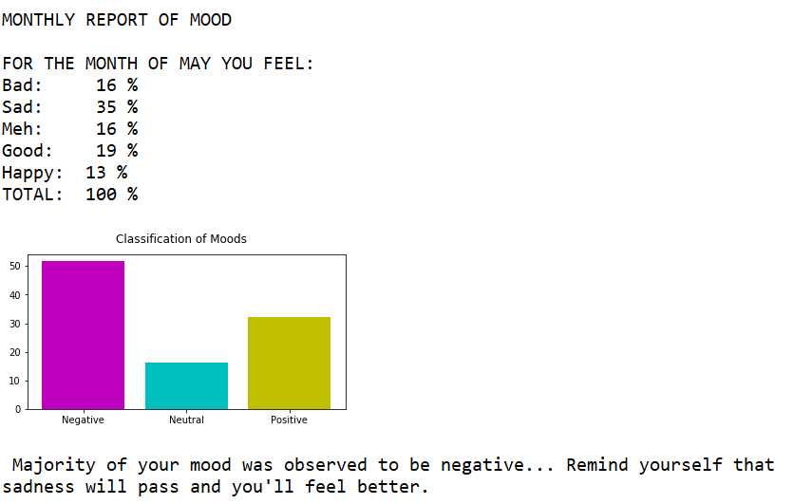
How the program works…
Figure 3. Display of table
Figure 4. Display of monthly report

Slide 22
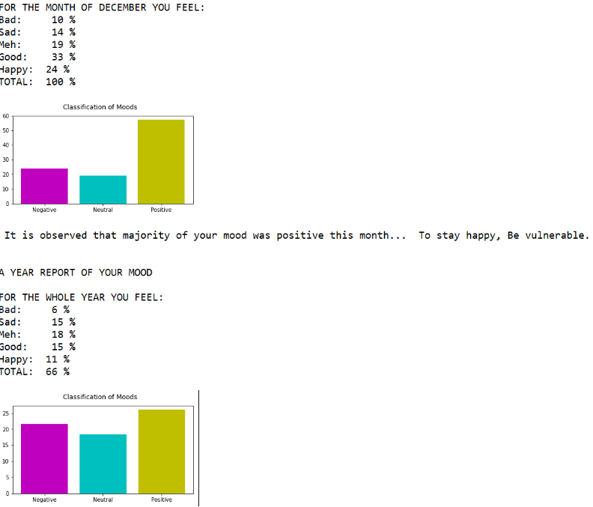
How the program works…
Figure 5. Display of year-end evaluation and end of program

Slide 23
Chapter 5
Conclusion and
Recommendations

Slide 24
Conclusion
MoodLy: Daily Mood Tracker
Minimizes time spent in reflective activity
Ensures that reflective activity was done consistently
Secures safety of the information
Encourages people to have a habit of checking their mental state
Aims to bring back the traditional self-reflective activities
Answers the SDG: Good health and well-being

Slide 25
Recommendations
Should have Graphic User Interface
Should automatically run as the date changes.
Should prompt the user in a certain time of the day.

Slide 26
Recommendations (continuation)
Should contain advices that was approved by the psychologists or mental therapists.
Should have critical observation of the moods approved by the psychologists and statisticians.
Should have statistics that can be a basis of the features of the program or application.

Slide 27
Bibliography
DAYLIO features. (n.d.). Retrieved from DAYLIO: https://daylio.webflow.io/
Freedman, J. (2017, May 15). Emotions, Feelings and Moods. Retrieved from sixseconds: https://www.6seconds.org/2017/05/15/emotion-feeling-mood/
Grid Diary Classic. (2019). Retrieved from App store: https://itunes.apple.com/au/app/grid-diary-personal-gratitude/id597077261?mt=8
Guzman, S. s. (2018, August 27). Mental health of Filipinos today. Retrieved from PhilStar Global: https://www.philstar.com/opinion/2018/08/27/1846128/mental-health-filipinos-today
Health Encyclopedia. (2019). Retrieved from University of Rochester Medical Center: https://www.urmc.rochester.edu/encyclopedia/content.aspx?ContentID=4552&ContentTypeID=1
Monitoring your Mood. (2017, December). Retrieved from Better Health Channel: https://www.betterhealth.vic.gov.au/health/HealthyLiving/monitoring-your-mood#
MoodPanda. (2019). Retrieved from Mood panda Help: http://www.moodpanda.com/help.aspx
Powers, J. (2018, June 15). What is a Mood Tracker and Why You Need One in Your Life? Retrieved from ENITTY: https://www.entitymag.com/mood-tracker/

